Slide 2
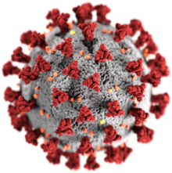

STAY HOME, STAY SAFE, STAY AWAY FROM CORONA
We care for you
PARVVA is now providing
Online Consultation + Follow up services to everyone + Medicines delivery to you at your doorstep!
Till normalcy is back
For any queries or to talk to our doctor call us on : +91 6364911469/368

Slide 3




CELEBRATING WOMANHOOD
28th March 2020
FREE INFERTILITY CAMP
Previous failure of IUI/IVF
PCOD/Endometriosis
Uterine fibroid
Irregular menstrual periods
Fallopian tubes defects
Reduced sperm count
Reduced sperm motility
Decreased quality of sperm
Azoospermia
And sometimes against all odds, against all logics we still have hopes!!!!
PARVVA DIAGNOSTICS AND HEALTH CARE
Reliance building, Malagala main road, Nagarbhavi 2nd stage, Bengaluru 560072
Phone number : +91 6364911469 /368 E-mail : pdhc@mail.com

Slide 4

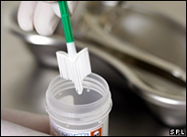
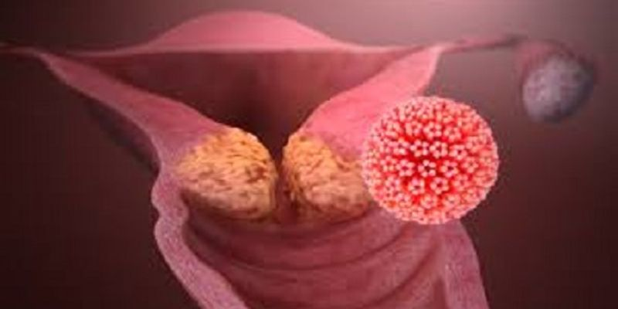
CANCER CERVIX IS PREVENTABLE
4th April 2020
Cervical cancer can be prevented by undergoing regular screening through co-testing of Liquid Based-Cytology (LBC) and HPV DNA Genotyping Test
HPV DNA Test
The test enables early detection of cervical cancer by detecting the presence of HPV virus even before cell changes in the cervix have occurred
Liquid based cytology (LBC)
LBC screen for cell changes or the presence of abnormal or pre-cancerous cell that can be effectively prevent cervical cancer
30% OFF
PARVVA DIAGNOSTICS AND HEALTH CARE
Reliance building, Malagala main road, Nagarbhavi 2nd stage, Bengaluru 560072
Phone number : +91 6364911469 /368 E-mail : pdhc@mail.com

